Slide 1
LET’S TRY SOME!
For each of these data sets, write up the assumption statement with respect to checking the assumptions for a one or two sample t-test. You may assume the data to be independent.
Happiness Data Set
Mice Experiment Data Set

Slide 2
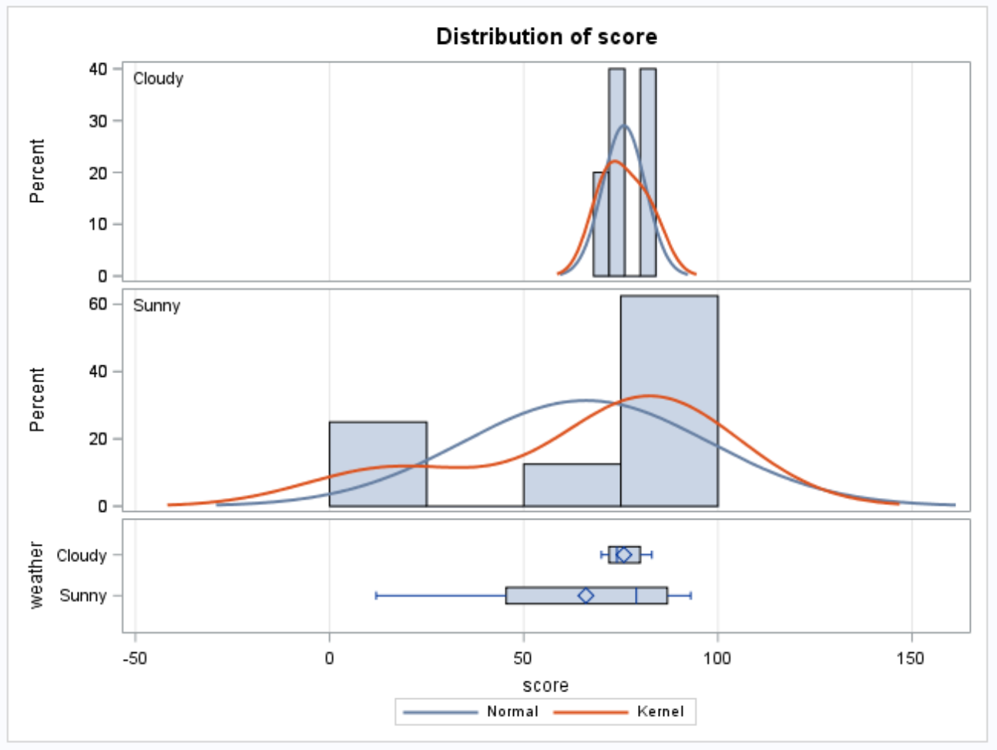
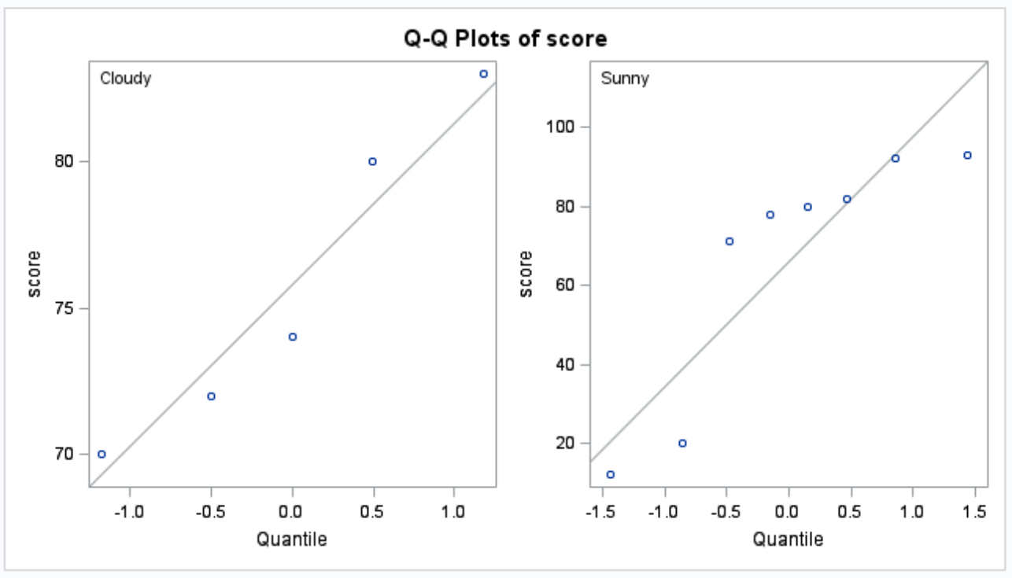
Happiness Study
5 randomly selected people were asked to rate their happiness on a scale from 1 – 100 on a cloudy day and 8 randomly selected people were asked the same question on a sunny day.
QOI: Is the mean happiness of individuals different on a cloudy day than a sunny day? If possible, can we test if cloudy weather causes a change in happiness?
Address each assumption of the two sample t-test and then decide if the two-sample t-test appropriate to answer this QOI with this data.

Slide 3
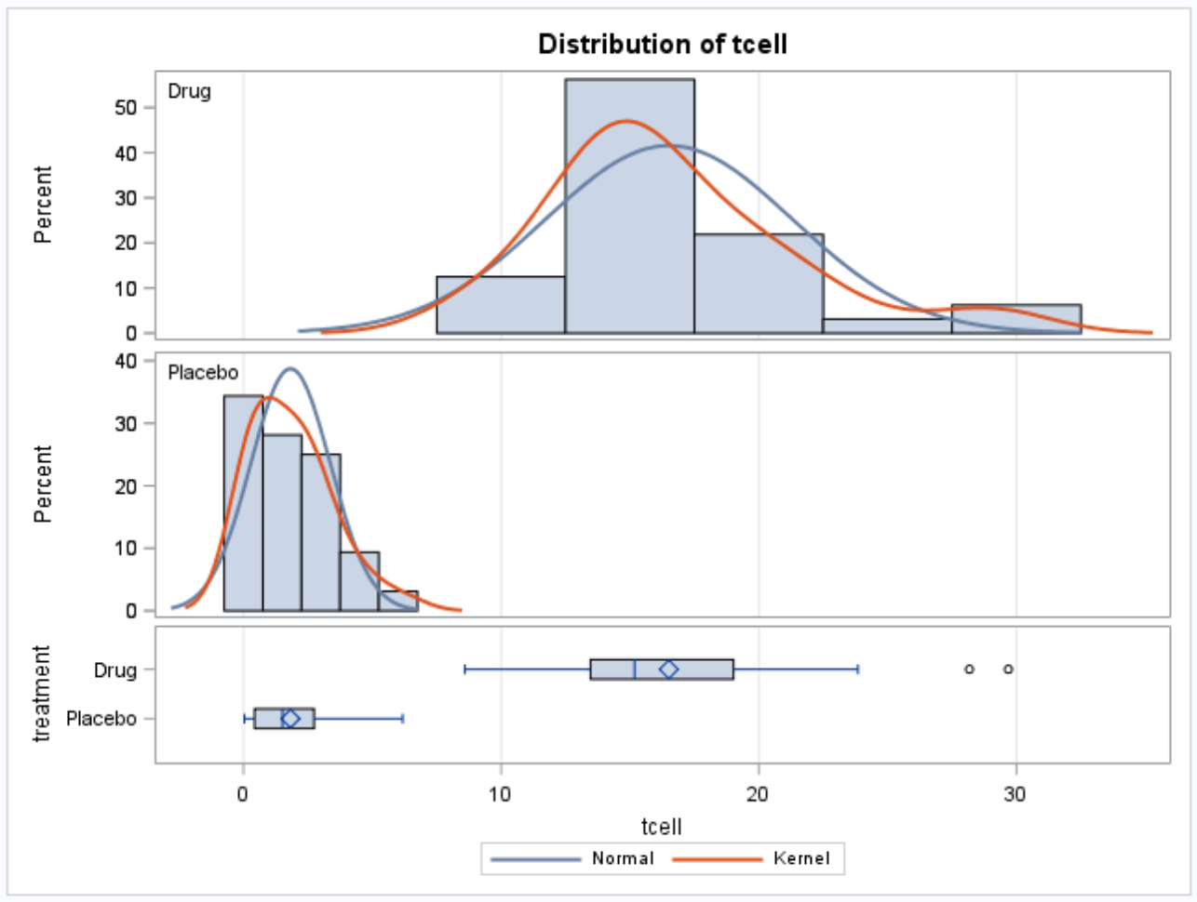
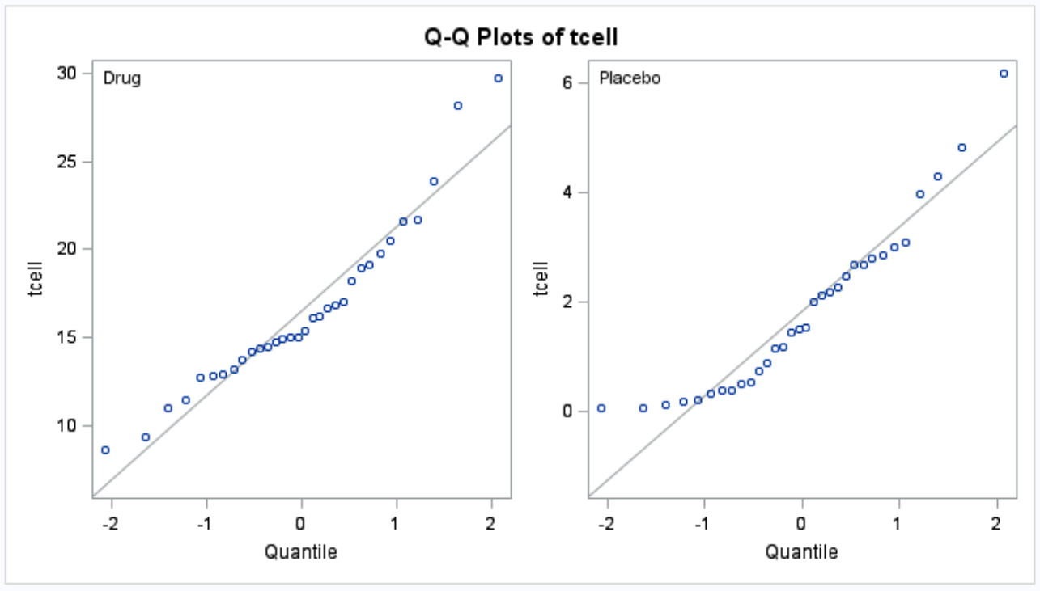
Mice Study
A large sample of mice were randomly assigned to receive a drug or a placebo. The mice’s tcell counts were then taken and histograms and qq plots are displayed above.
QOI: Is the mean tcell count of mice that receive the drug greater than that of the mice that receive the placebo?
Can we draw draw evidence of causality from this study?
Address each assumption of the two sample t-test and then decide if the two-sample t-test appropriate to answer this QOI with this data.

